Slide 1
Self-Budgeting Application Transition from Waterfall to Scrum
Chaitanya Durgesh Nynavarapu - A20561894
Niranajaan Veeraraghavan Munuswamy - A20552057
Dresha Reddy Bommana - A20546970
Ashish Reddy Thumu - 20560560

Slide 2
Introduction to Transition:
The Self-Budgeting Application helps users track income, expenses, set budgets, and create financial reports. Transitioning from Waterfall to Scrum allows for continuous feedback and iterative development, providing greater flexibility.

Slide 3
Review of Phase 1 Waterfall Plan
In Phase 1, Waterfall methodology was used with stages for Requirements, Design, Implementation, Testing, and Documentation.
Key areas identified for adaptation:
Increased flexibility.
Improved user feedback loops.
Iterative progress and refinement.

Slide 4
Scrum Team Structure
Roles:
Product Owner: Manages backlog and sets priorities.
Scrum Master: Facilitates Scrum events, ensures process adherence.
Development Team: Developers, QA Engineers, UI/UX Designers.
DevOps Engineer: Ensures smooth deployment.
These roles support iterative budgeting feature delivery and feedback integration.

Slide 5


Developing the Product Backlog
Converted Waterfall requirements to user stories:
'Track daily expenses by category to monitor spending.'
'Set monthly budgets and receive alerts when nearing limits.'
Stories are prioritized based on business value and user impact.

Slide 6

Sprint Planning and Initial Sprints
Sprint Length: 2 weeks
Sprint Goals:
Sprint 1: Income tracking setup and initial UI.
Sprint 2: Expense tracking and category features.
Sprint 3: Budget setting, notifications for budget limits.
Sprint 4: Testing, feedback incorporation, documentation.

Slide 7
Outline of Scrum Events :
Core Scrum Events:
Sprint Planning: Define goals and sprint backlog.
Daily Scrums: Progress updates and addressing blockers.
Sprint Review: Present increments and gather feedback.
Sprint Retrospective: Reflect on improvements for the next sprint.

Slide 8
Defining Scrum Artifacts
Scrum Artifacts for Self-Budgeting Application:
Product Backlog: List of all budgeting-related features.
Sprint Backlog: Items selected for the current Sprint.
Increment: Budgeting features completed each Sprint.

Slide 9
Estimation Techniques
Estimation using story points:
Story points based on complexity and effort required.
Tasks are sized relative to one another, enabling consistent planning across sprints.
Effort = Work / Productivity Rate

Slide 10
Designing the Scrum Board
The Scrum board has columns for:
To Do
In Progress
Testing
Done
The board visualizes task progress throughout each sprint.

Slide 11

Definition of Done :
Criteria for 'Done':
Code meets standards and passes tests
Integrated with other features
Documentation updated
Ensures consistency and completion across sprints.

Slide 12
Developing a CI/CD Plan
The CI/CD plan supports iterative development:
Continuous Integration: Regularly merging and testing code
Continuous Deployment: Automating releases based on approvals
Enables seamless deployment of incremental budgeting features.

Slide 13

Analysis Report: Waterfall vs. Scrum
Waterfall vs. Scrum for Self-Budgeting Application:
Scrum provides flexibility, early feedback, and adaptability.
Waterfall limits iterative refinement.
Scrum aligns with the needs of iterative financial management.

Slide 14

Metrics and Reporting
Key Performance Indicators (KPIs):
Sprint Velocity: Measures team productivity
Defect Density: Ensures quality control
User Feedback: Tracks user satisfaction and app functionality
Tracking these metrics supports continuous improvement.

Slide 15
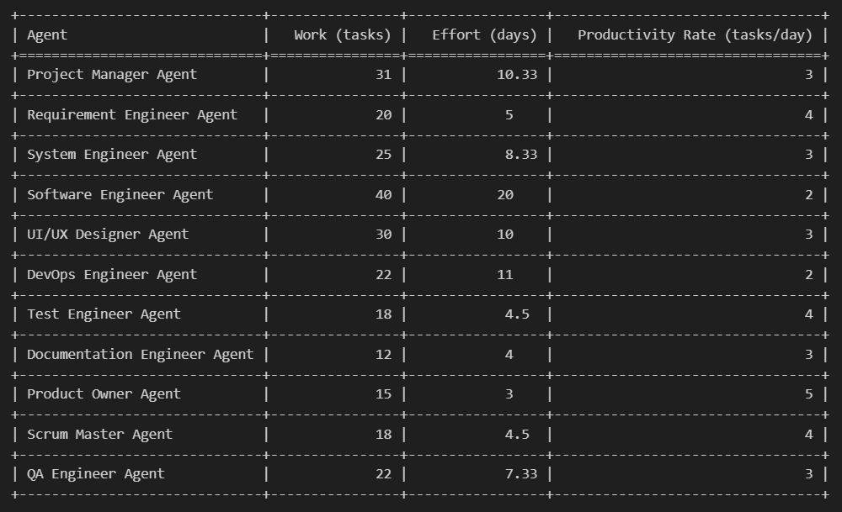
Output

Slide 16

Conclusion
Scrum’s iterative and flexible nature benefits budgeting app development by allowing:
Early feedback
Adaptive planning
Incremental delivery of critical budgeting features.
Expected outcomes include improved flexibility, better feedback integration, and enhanced user satisfaction.

